Slide 1
SHIFT4IT
Shifting the paradygm for women in IT sector

Slide 2
Introduction to UX-UI

Slide 3
Module Program
Hello world!
Introduction to UX & UI
Principles of ergonomics and design
Information Architecture
Design system & Prototyping
User research/ Testing
Design thinking
Accessibility
Metrics
Project

Slide 4

Two truths and a lie
Source: https://pixabay.com
Notes:
Preparation: Each participant thinks of three statements about themselves: two true and one false.
Presentation: In turn, each person shares his or her three statements with the group.
Deduction: The others discuss and debate which statement is a lie.
Revelation: The person announces the answer and can give further explanation of their truths.
The three statements could read like this, for example:
I play the didgeridoo.
I speak four languages fluently.
I have never drunk alcohol in my life.

Slide 5
Summary
In this first lesson, you will explore the fundamentals of User Experience (UX) and User Interface (UI) design.
You’ll see how UX focuses on understanding users and crafting digital experiences that are intuitive and satisfying, while UI shapes the visual and interactive elements—like layout, color, and navigation.
You’ll also learn that great UX/UI design starts with research, evolves through prototyping, and improves through testing—always keeping the user at the center.
By the end, you’ll understand the purpose of UX/UI design, its role in product development, and why it’s essential for creating user-friendly digital products.

Slide 6
Introduction to UX & UI
“Design is not just what it looks like and feels like.
Design is how it works”
Steve Jobs
Notes:
An attractive design may momentarily grab your attention. However, an exceptional design evokes a sense of connection, comprehension, ease, and effortless engagement. This leads to a desire for repeated use. This is precisely why the concept of Design has evolved to a higher standard. Nowadays, users evaluate products from every angle. Contemporary designers create functional items.

Slide 7
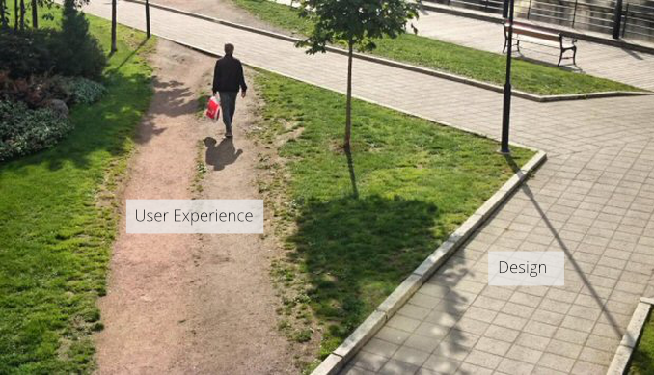
Introduction to UX & UI
…
Source: https://medium.com/
Notes:
a picture is worth a thousand words

Slide 8
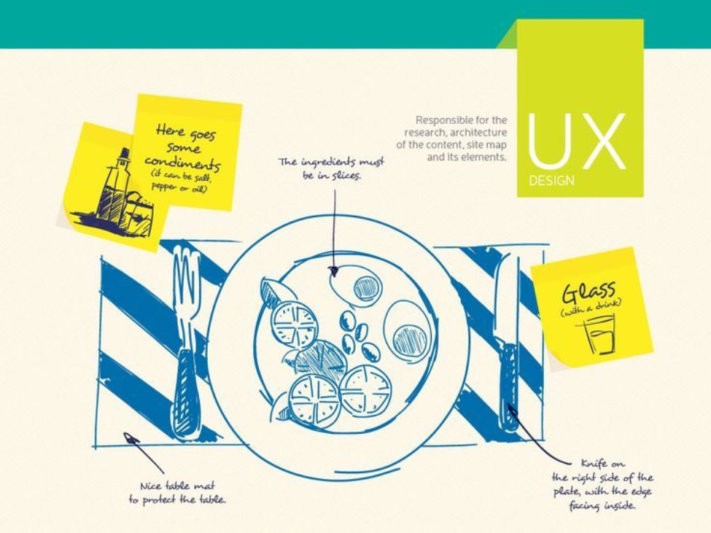
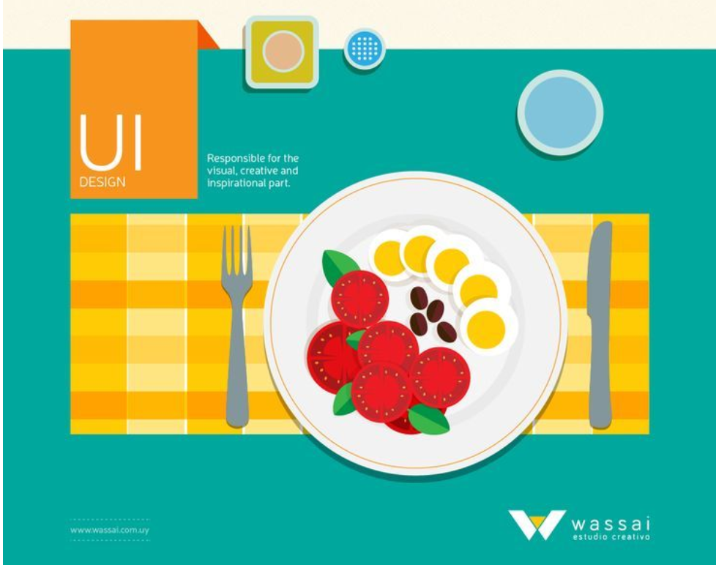
Definitions
UX design: User Experience Design
UI design: User Interface Design
Source: https://anmadesign.com/differences-entre-ui-ux/
Notes:
User experience (UX) and user interface (UI) are two different concepts that cannot be dissociated. The UI is what the user sees, while the UX is what the user can do with what he or she has just seen.
The UX Designer's mission is to improve usage, to conceive and imagine new ideas to define the project's concept, while the UI Designer takes care of the project's technical aspects and the realization of the experience.

Slide 9
Benefits of UI/UX design
Customer acquisition & retention
Reduces development costs and time
Facilitates ease of navigation
Boosts branding
Improves conversion rates
Helps with SEO
Improves website speed
Reduces the need for customer service
Enhances user experience
Gives competitive edge
Notes:
Benefits of UI/UX Design
Customer Acquisition & Retention – A well-designed UI/UX attracts new users and keeps them engaged, increasing loyalty.
Reduces Development Costs & Time – A structured design process helps identify issues early, saving time and resources.
Facilitates Ease of Navigation – Intuitive interfaces ensure users can find what they need quickly and efficiently.
Boosts Branding – A strong UI/UX enhances brand identity and credibility.
Improves Conversion Rates – A seamless experience encourages users to take desired actions, such as signing up or making purchases.
Helps with SEO – Well-structured, user-friendly sites rank better in search engines.
Improves Website Speed – Optimized UX/UI reduces load times, enhancing performance.
Reduces the Need for Customer Service – Clear design minimizes confusion, reducing support requests.
Enhances User Experience – A smooth, enjoyable interaction increases user satisfaction.
Gives Competitive Edge – Superior UI/UX makes a product stand out in a crowded market.

Slide 10
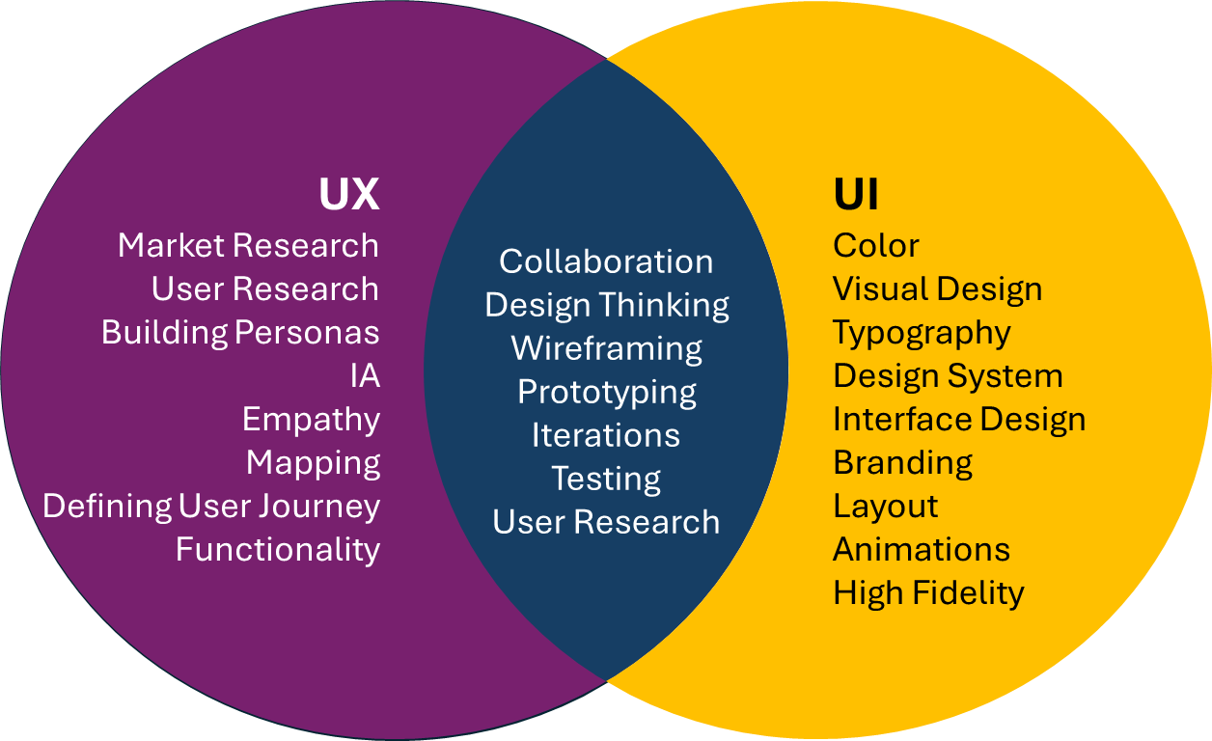
UI vs UX DESIGN
Key differences
Notes:
UX:
Market Research: Understanding industry trends and user needs.
User Research: Studying users’ behaviors, goals, and pain points.
Building Personas: Creating fictional user profiles based on research.
IA (Information Architecture): Structuring content for easy navigation.
Empathy: Understanding users' feelings and perspectives.
Mapping: Visualizing relationships or steps (e.g. journey maps).
Defining User Journey: Outlining the steps users take to achieve a goal.
Functionality: Ensuring features meet user needs and expectations.
BOTH:
Collaboration: Working across teams to create better user experiences.
Design Thinking: A human-centered process for creative problem-solving.
Wireframing: Basic layout sketches of interfaces before design details.
Prototyping: Interactive mockups to test functionality and flows.
Iterations: Repeated improvements based on feedback.
Testing: Validating design choices with real users.
User Research: Gathering insights to inform design decisions.
UI:
Color: Used to set mood, highlight elements, and support brand identity.
Visual Design: Overall look and feel of the interface.
Typography: Style and arrangement of text for readability and impact.
Design System: A set of standards and components for consistent UI.
Interface Design: Designing how users interact with digital products.
Branding: Visual identity that reflects the company’s personality.
Layout: Organization of elements on a screen.
Animations: Motion effects that guide or engage users.
High Fidelity: Detailed, polished mockups close to final design.

Slide 11
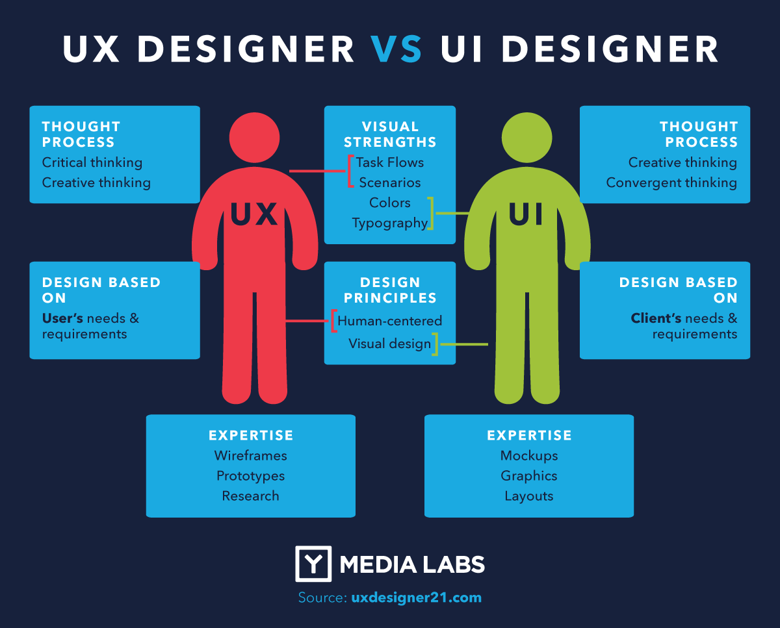
UI vs UX DESIGN
Job description

Slide 12
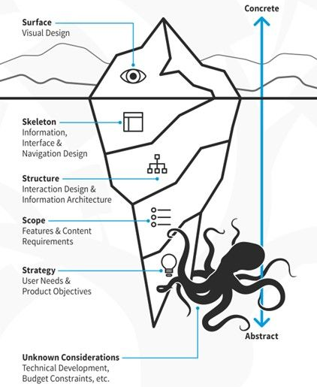
5 Levels of the User Experience
Design by James Garrett
The 5 levels help to deconstruct the process of working on UX, enabling a step-by-step design process, moving from the basics to the details. This method helps create a solid product which meets all the requirements from the customers and from the business.
Source: https://www.interaction-design.org/
Notes:
The five elements of UX design form a structured approach to creating user-centered products:
Strategy – The foundation of UX design, where product objectives are defined and aligned with both business goals and user needs. Research is essential to understanding what users expect and ensuring the design is purposeful.
Scope – Determines what the product will include and how it will function. It involves defining features, content requirements, and ensuring everything works together to provide a seamless experience without overwhelming users.
Structure – Focuses on interaction design and information architecture. It ensures users can navigate the product intuitively by organizing content and interactions logically.
Skeleton – The visual blueprint, including wireframes and prototypes, that defines the placement of interface elements like buttons, images, and text. The goal is to create an intuitive layout that users can interact with effortlessly.
Surface – The final layer, where visual design elements such as typography, color, and imagery come into play. This phase enhances the sensory experience and ensures a balance between aesthetics and functionality for an engaging user experience.
Each layer builds upon the previous one, creating a user-friendly and visually appealing product.

Slide 13
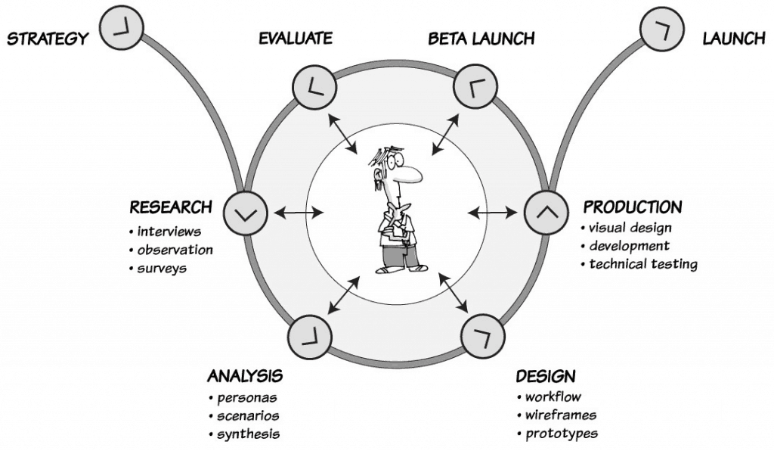
UX process
Source: https://uxmastery.com/
Notes:
The UX process consists of five key phases:
Strategy – Defines the brand, guiding principles, and long-term vision. It shapes project goals, success metrics, and priorities.
Research – Also called the Discovery phase, it varies in depth depending on the project. It involves user and competitor research to inform the design process but is often skipped in Lean UX approaches.
Analysis – Extracts insights from research data to understand user needs and validate assumptions.
Design – A collaborative and iterative process where ideas are tested with users through low-fidelity prototypes.
Production – Finalizes high-fidelity designs, creates digital assets, and works closely with developers to implement and validate the product.
While these phases resemble a linear waterfall model, UX design is inherently iterative, requiring constant feedback, revisions, and stakeholder communication. This aligns with Agile development and Lean Startup principles, ensuring continuous improvement based on user input. Effective communication is crucial for securing stakeholder buy-in and ensuring project success.

Slide 14

Introduction to project
CraftEase / DIYHub is a web application solution developed for home improvement retailers who want to enhance customer engagement directly through their website.
Our goal is to provide your store with an integrated digital service that helps manage DIY workshop registrations, promote project tutorials, and track tool/material availability in real time.
Source: https://uxwing.com/
Notes:
CraftEase / DIYHub is a web application solution developed for home improvement retailers who want to enhance customer engagement directly through their website. Our goal is to provide your store with an integrated digital service that helps manage DIY workshop registrations, promote project tutorials, and track tool/material availability in real time.
The platform is designed to be seamlessly embedded into your existing website. It is user-friendly, secure, and adaptable to your branding and customer needs. Features include personalized project recommendations, booking management, customer feedback tools, and analytics for store teams.
By offering this added-value service, your store becomes more than a point of sale — it becomes a DIY destination.

Slide 15
UX-UI practical glossary
50 UI/UX Terms Explained with Examples and Tools
→ Check the PDF ☺

Slide 16
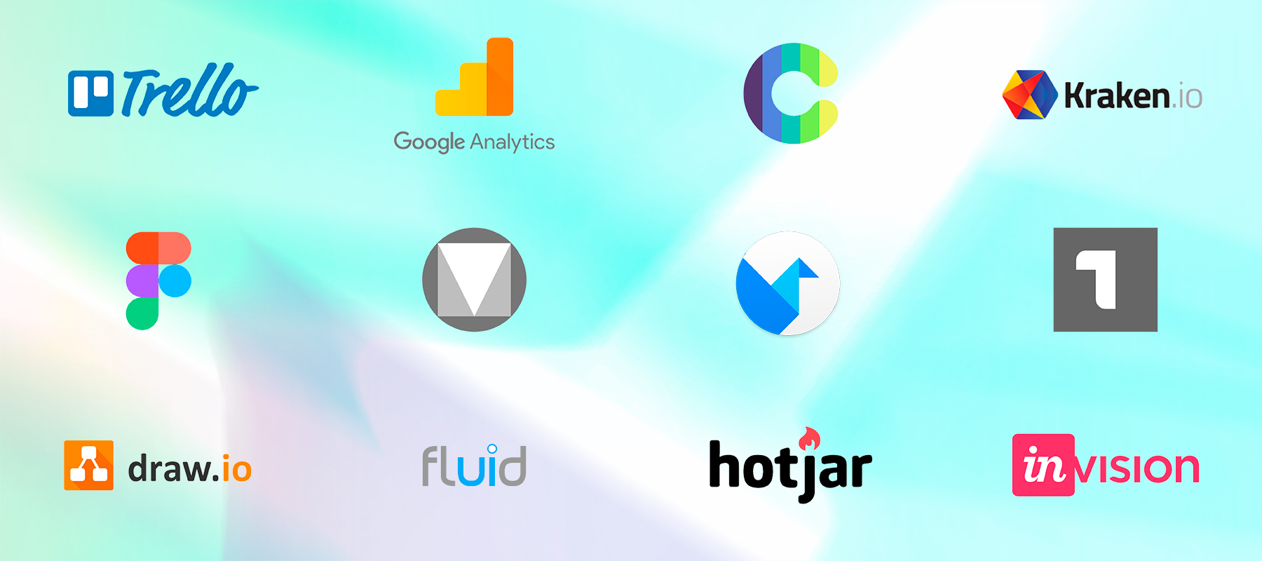
Best free UI/UX tools
→ Check the PDF ☺
Source: https://dorve.com/blog/top-25-free-tools-for-ux-ui-and-web-designers/

Slide 17
Ressources
https://www.checklist.design/
https://www.ux-checklist.com/
https://uxrecipe.github.io/

Slide 18
Additional readings
https://www.smashingmagazine.com/2018/02/comprehensive-guide-ui-design | A Comprehensive Guide To UI Design
https://uxplanet.org/ | One-stop resource for everything related to user experience
https://openclassrooms.com/en/paths/76-ux-designer | UX designer online training
https://www.figma.com/resource-library/difference-between-ui-and-ux/ | UI vs UX: What's the Difference between UI & UX Design?
https://careerfoundry.com/en/blog/ux-design/the-difference-between-ux-and-ui-design-a-laymans-guide/ | UI vs UX: What's the Difference between UI & UX Design?
https://www.solulab.com/role-of-ux-in-modern-web-design/#:~:text=User%20experience%20in%20web%20design,the%20success%20of%20digital%20platforms | The Role of UX (User Experience) in Modern Web Design
https://www.interaction-design.org/literature/topics/ux-design | What is User Experience (UX) Design?
https://www.uxpin.com/studio/blog/guide-design-consistency-best-practices-ui-ux-designers/ | Design Consistency Guide UI and UX Best Practices
https://baymard.com/learn/ux-design-principles | The Best Practices and Key Principles of UX Design

